Slide 1
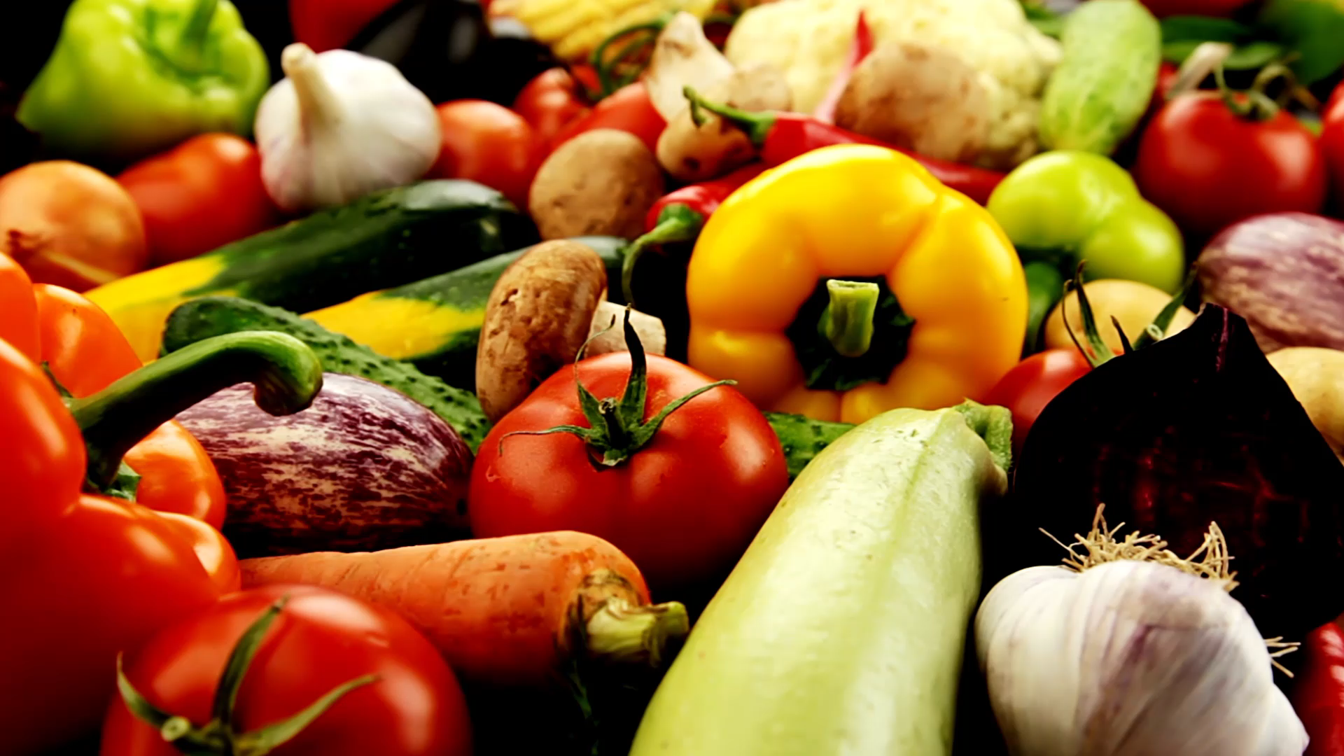
Promoting Healthy eating & balanced diet

Slide 2
Agenda:
Team Members
Improvements form professor feedback
Project description
Problem statement
Minimal Viable Product (MVP)
Technologies
Architecture diagram
Sprint2 Recap
Product backlog
Sprint backlog
Metrics
Retrospective​
Sprint4
Project Demo
Live application demo
Github link
Live Application Demo

Slide 3
IMPROVEMENTS MADE FROM PROFESSOR FEEDBACK
Professor feedback | Improvement
Professor suggested us to add components to the Architecture diagram | We Updated our Architecture diagram
Our MVP was not clear and concise | We Focused on the things that are to be included as part of our MVP
User stories and acceptance criteria was misunderstood | We made changes as suggested by professor

Slide 4
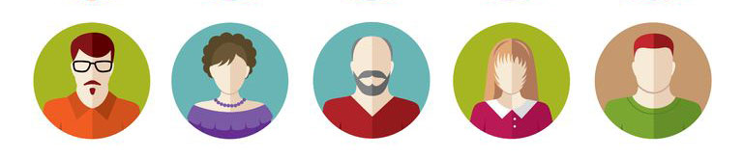
Meet the team

Slide 5
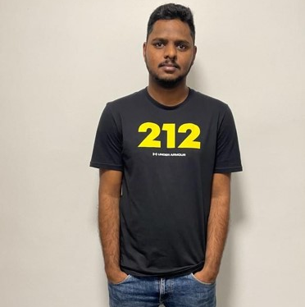
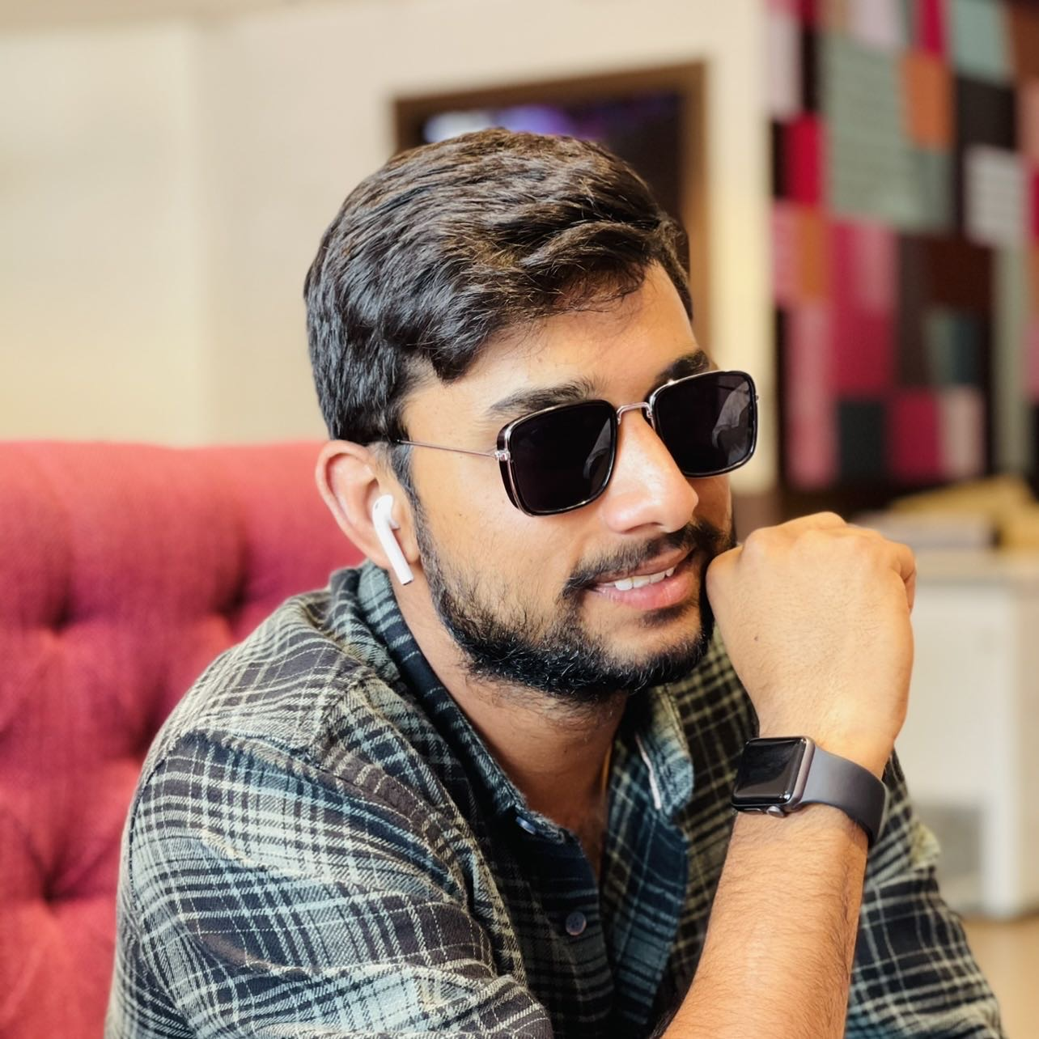
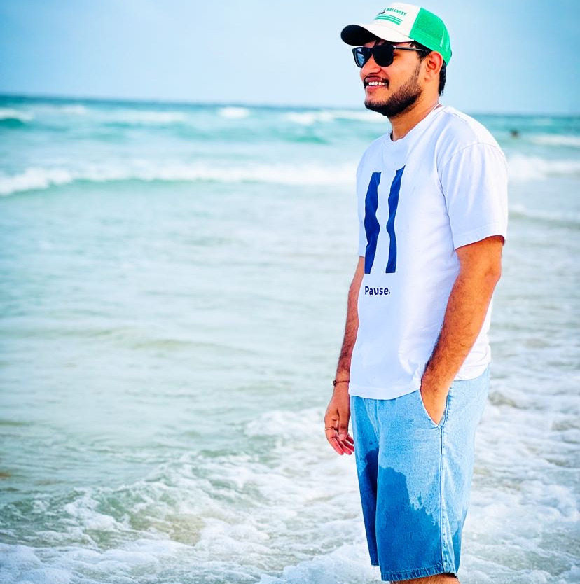
SATHWIK MUDENTI
VARUN REDDY DUGGIMPIDI
NARESH BABU CHINTA
BACKEND DEVELOPER
BACKEND DEVELOPER 2
QA/TESTER

Slide 6
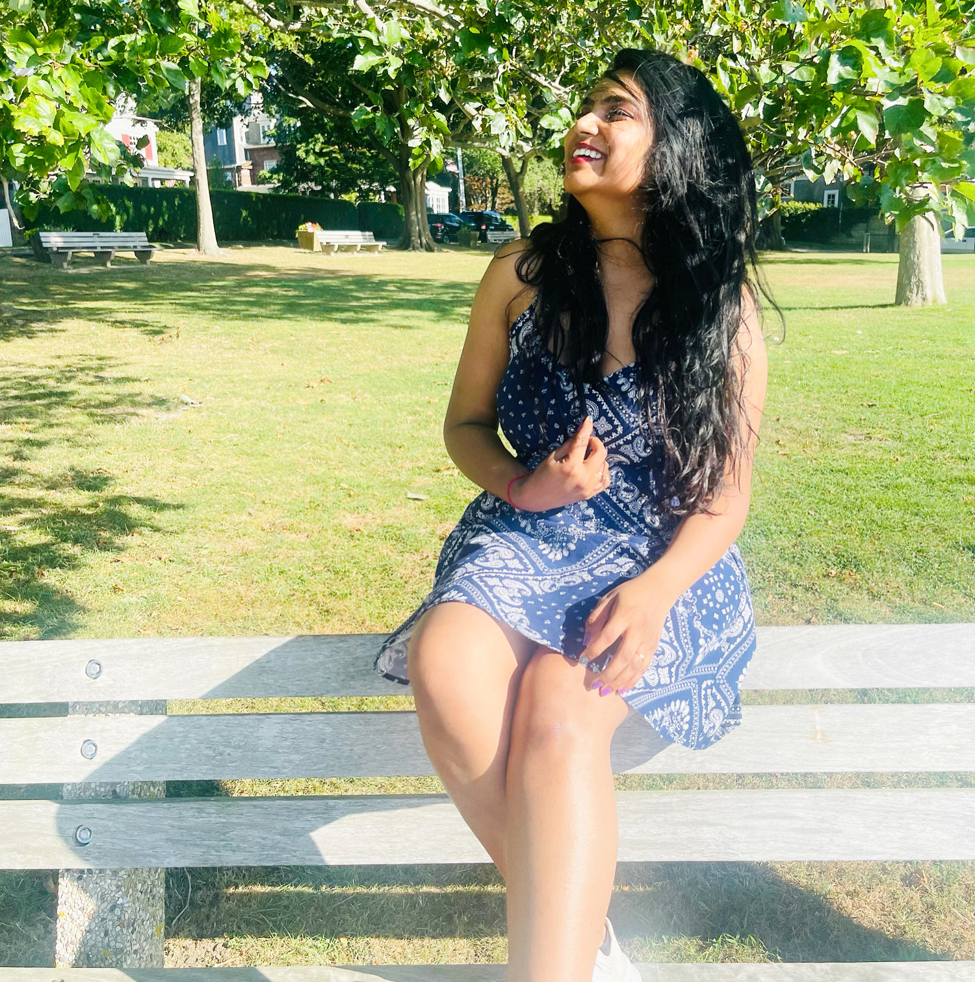
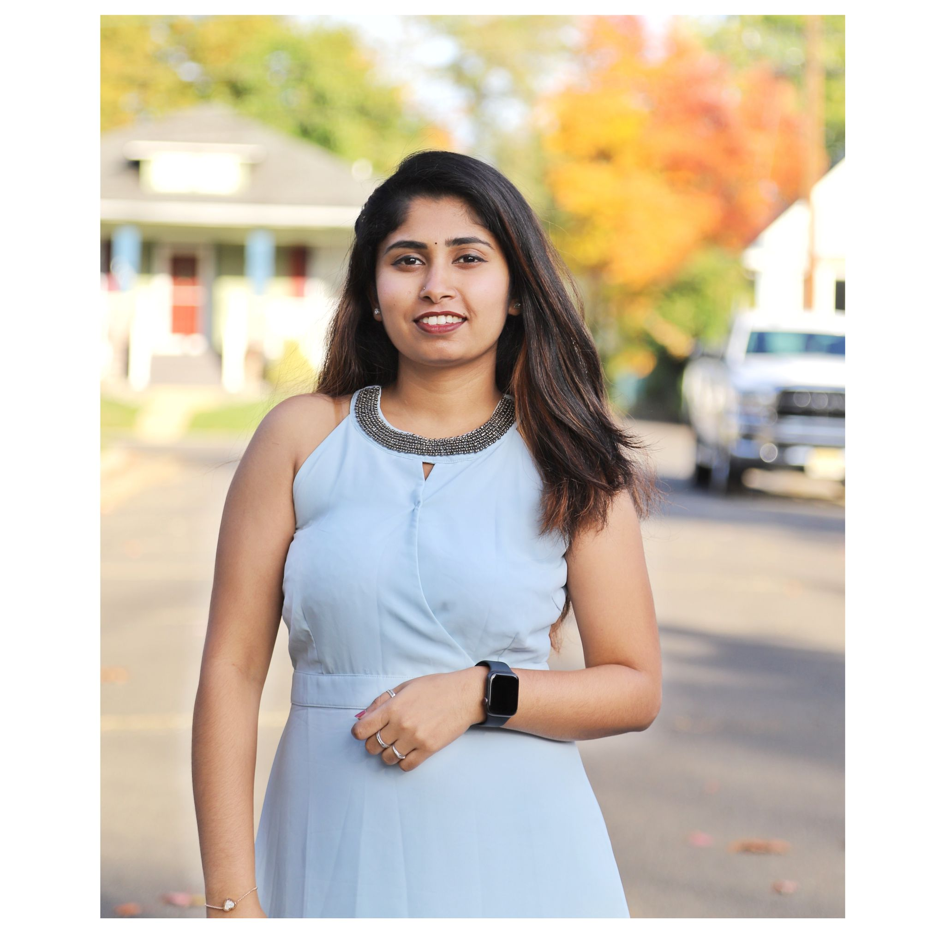
Dharini Maanasa
BRUNDA REDDY
FRONTEND DEVELOPER
DBA

Slide 7
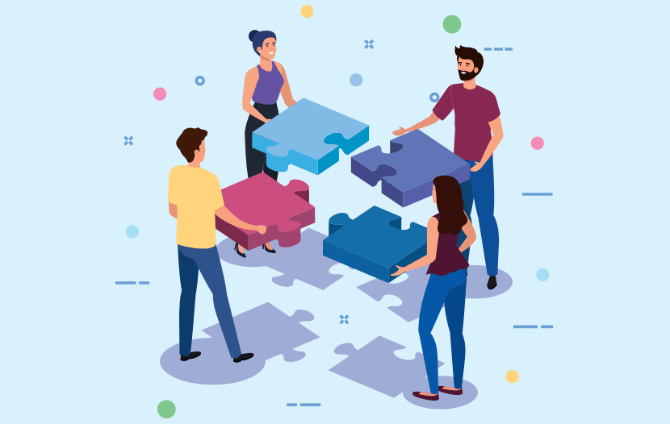
TEAM
RESPONSIBILITIES

Slide 8
We makes sure team has clear objectives of the project.
Make a list of all the tasks that need to be completed.
Being engaged and stay committed to submit deliverables on time.
Encouraging each other to complete the tasks given.
Understanding what is expected and what needs to be delivered.
Making sure every teammate providing the equal amount of contribution.
Providing the feedback within the team to perform better.

Slide 9

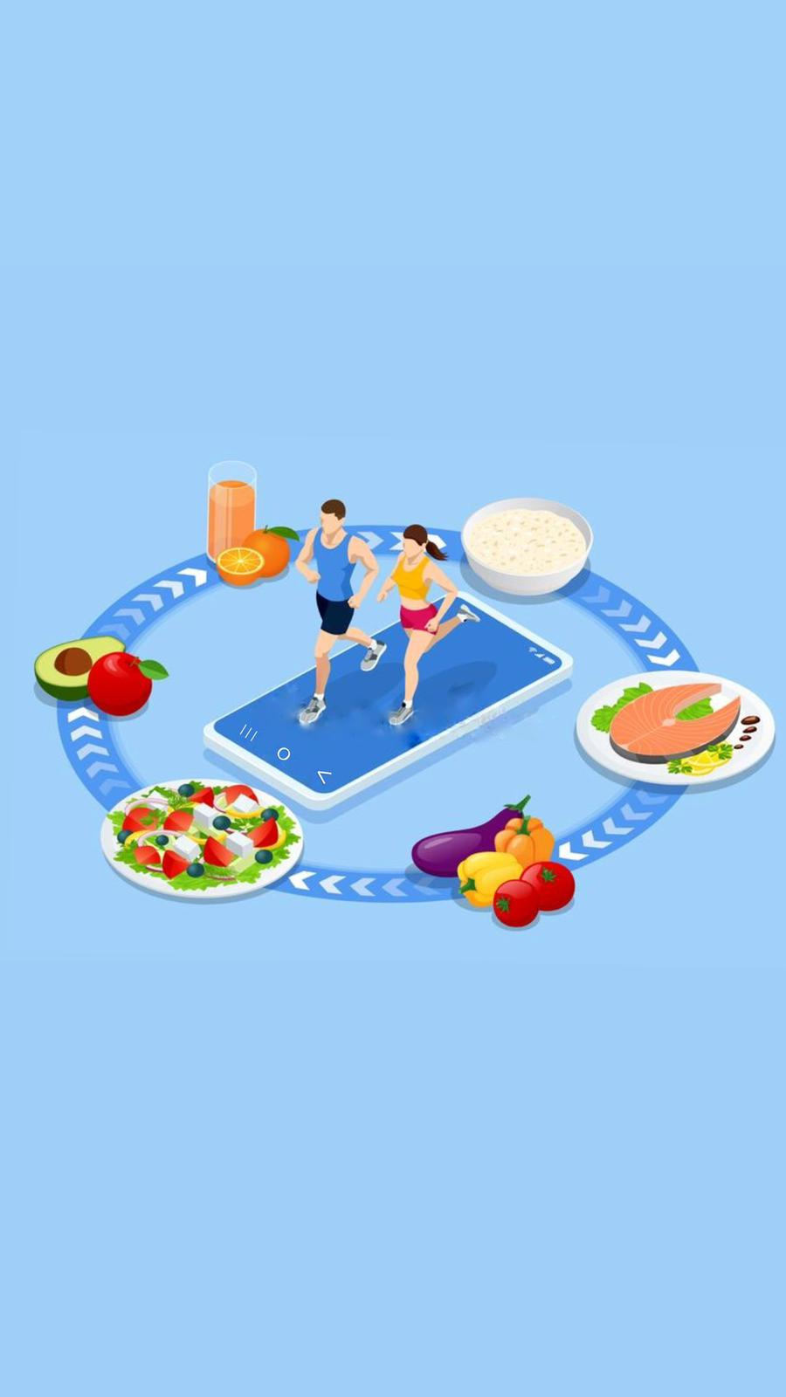
PROBLEM statement

Slide 10
PROBLEM STATEMENT:
People like to taste different cuisine and choose the most appealing food. They often are concerned about diet restrictions such as gluten-free, vegan, ketosis, peanut-allergy, and calorie count.
We would like to provide an easy solution to making health and good foods that fit your daily calorie consumption limit.

Slide 11
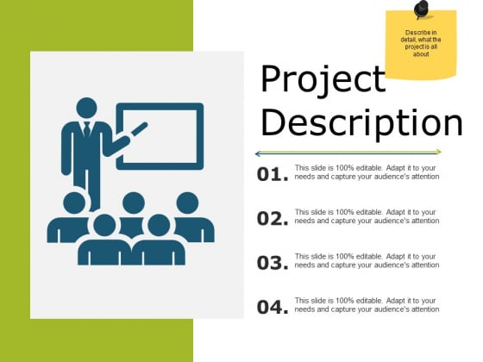
PROJECT
DESCRIPTION

Slide 12
The project focuses on four major problem statements:
Food Classification.
Recipe Generation.
Balanced Diet.
Calorie Estimation.
From the image of food captured, we determine the classification of food (such as donut, samosa, biriyani), identify the calorie count and describe the cooking procedure of the food. With this information, an informed decision can be made on making the item or not.

Slide 13
Food Classification:
Food classification is a challenging problem due to the large number of food categories, high visual similarity between different food categories.
It’s multi-class classification problem to predict the 251 fine-grained food-categories.

Slide 14
Recipe Generation:
Recipe Generation problem is resolved by three major sub-networks.
Food understanding (Extracting ingredients)
Multi-label classification (Detecting the food title)
Conditional text generation (NLP)(Preparing recipe)
The pipeline extracts the image representation with resnet-50 encoder and obtain the ingredients. Recipes are generated with identified ingredients into human readable format.

Slide 15
Balanced Diet:
A balanced diet is one that contains all the essential elements that the human body needs.
Carbohydrates, lipids, vitamins, minerals, proteins, fiber and water are all essential components in a well-balanced diet.
A nutritious, well-balanced diet lowers the risk of disease and enhances general health.

Slide 16
Calorie Estimation:
From the ingredients generated from Recipe module, we have computed the Calorie for the dish.
Each recipe provided us the nutritional value for every 100 grams.
Fat/ Saturation - Every gram of fat has 37 kilojoules.
Protein - Every gram of protein has 17 kilojoules.
Sodium - Every gram of sodium has 8 kilojoules.
Sugar - Every gram of sugar has 17 kilojoules.
Every kilojoule has 0.239006 calories.
Using this data we used the following formula to estimate calories.
0.24((fat * 37) + (protein*17) + (sodium *8) + (sugar * 17)) = total calories.

Slide 17
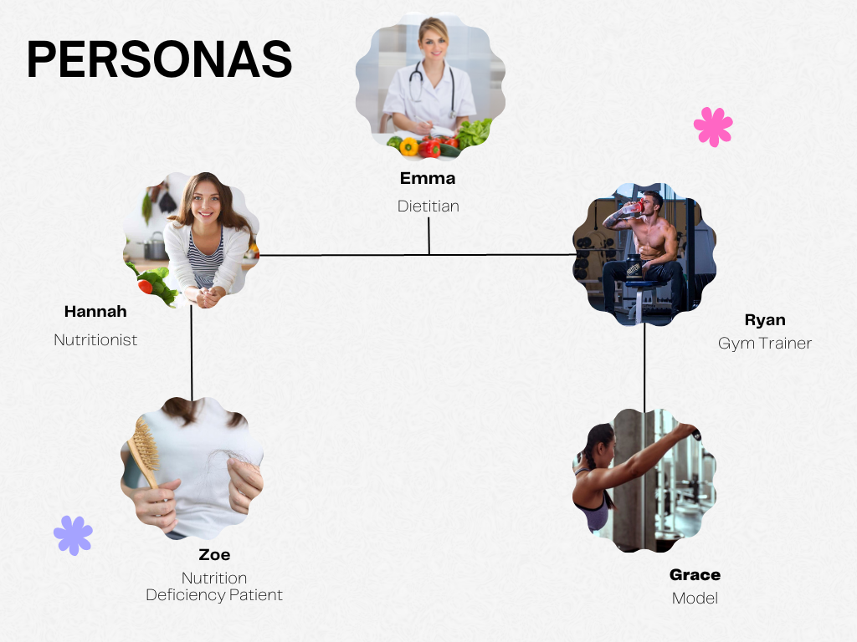

Slide 18

Elena
Dietitian
Elena is an expert Dietitian.
She is 33 years old beautiful dietitian.
She is a qualified health professional who helps patients with nutrient deficiency.
She is registered with the Commission of Dietetics Registration (CDR)
She has a license to practice as diet and nutritional consultant.

Slide 19

catherine
nutritionist
She is a certified Nutritionist .
She works with healthy people to promote healthy eating habits.
She helps in creating awareness to prevent diseases related to nutrient deficiencies.
She uses an online health assessments to curate a daily supplement routine tailored needs.
Catherine is smart enough to understand the people's health condition and helps to get medications, supplements to them.

Slide 20
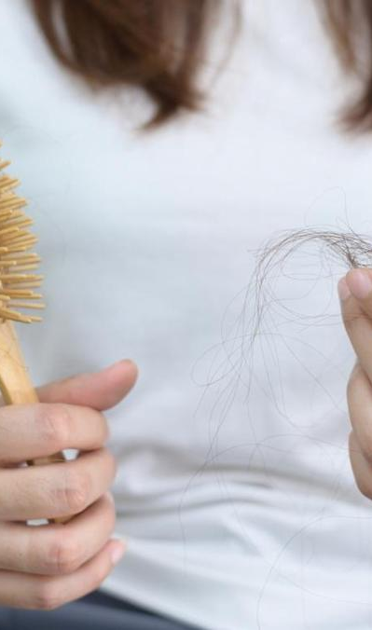
Zuan
Nutrition deficiency patient
Zuan is 24 years old who is suffering from Nutrition Deficiency
She has signs of B12 and suffering from dry skin, severe hair fall and brittle nails.
She need awareness about a good diet and healthy food habits.
She needs treatments including supplementation, change in diet, lifestyle and eating disorders.

Slide 21
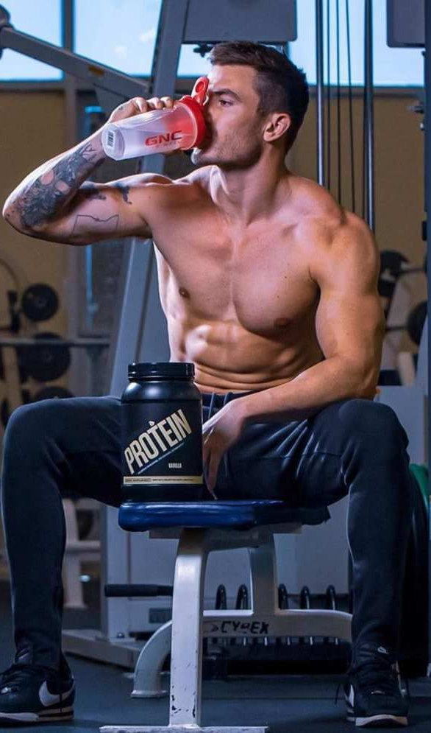
john
Gym trainer
John is a successful personal trainer in one of the best gyms.
He have a good knowledge about what his clients eat is as important as their training regimen.
He helps his client to reach their individual goals.
John knows having the right mix of calories and macros from whole foods is most important.
He make an individual diet plan for his clients.

Slide 22

grace
MODEL
Grace is 22 year - young and an upcoming model.
Grace loves to be active and physically fit.
She is very much concerned about the food she eats.
She spends 2 hours a day in gym.
She follows a proper diet provided by her trainer.

Slide 23
MINIMAL VIABLE PRODUCT

Slide 24
We would Like to Implement following features as a part of our MVP
User registration
Login
Home Page
Display all the features on the home screen of the Application
Implement a particular feature called Maintenance Calorie Calculator

Slide 25









TECHNOLOGIES

Slide 26
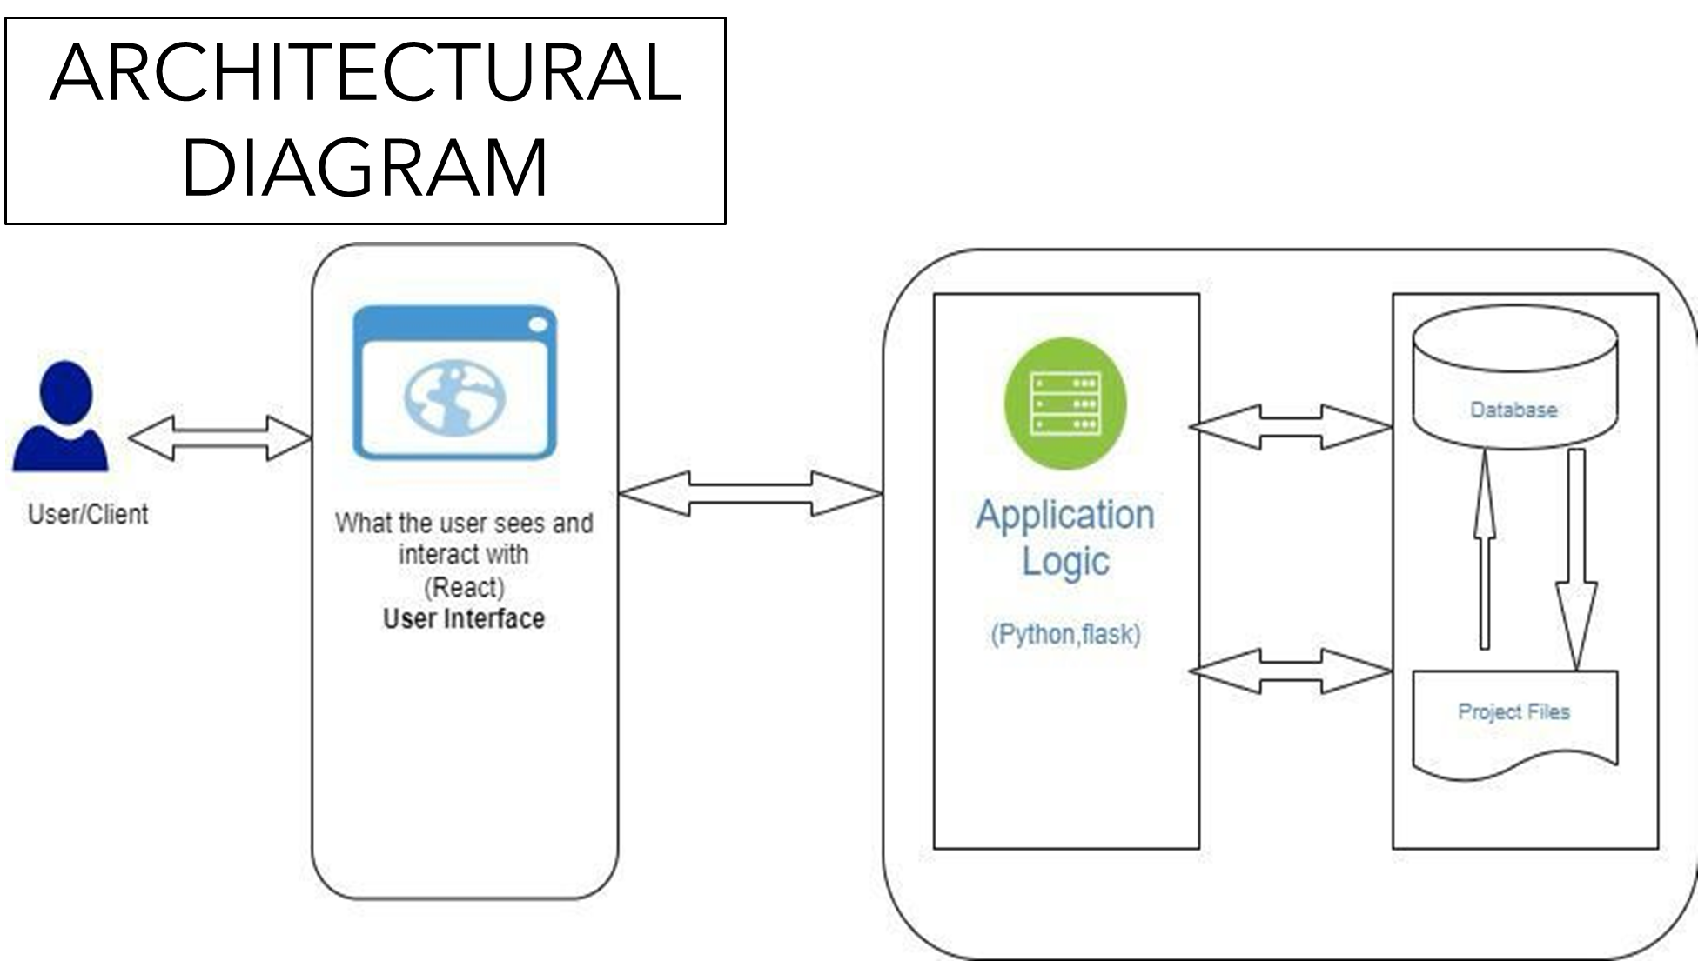

Slide 27
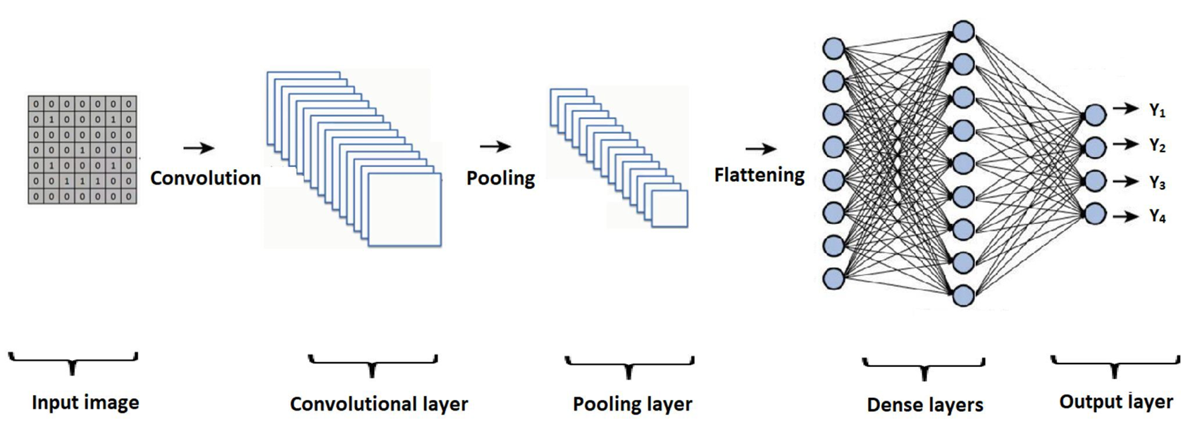
ARCHITECTURAL DIAGRAM

Slide 28
SPRINT 2 RECAP
We need to complete the MVP.
Need to create a Login Page.
Improvements made from professor’s feedback.
Product Backlog.
Stories that are planned for sprint.

Slide 29
SPRINT 2 Vs SPRINT 3:
Work on the Draft Paper.
Create login pages
Work on more user stories.
Created a new Architectural Diagram
Design Backend and Work on Database.

Slide 30


PRODUCT BACKLOG

Slide 31
*BACKLOG #Add dates(11 issues) 0 0 0 start sprint . . .
^SAT-1 User can register using email and create password
^SAT-2 User can login using his credentials
^SAT-3 Sending alert to the user when entered invalid email
^SAT-11 User gets an alert if he enters invalid password
^SAT-9 User can recover his password in case if he forgot his password
^SAT-10 User can choose a security questions to retrieve his account information
^SAT-4 User can enter his information like age,height,weight,activity status
^SAT-5 User can navigate to all the services listed in the application
^SAT-6 User can search on the website
^SAT-7 User can view his personal information
^SAT-8 User can edit his personal information

Slide 32
SPRINT BACKLOG

Slide 33
Tasks for the Sprint
Id | User story | Acceptance Criteria
SAT-1 | As a new user​ I want to register using email​ So that I can login to the application | scenario when user wants to register​ Given he registers​ Then his information gets stored​ And he can login using email and password
SAT-11 | As a new user​ I want to login to the application, but I enter wrong credentials​ So that I get alerted using a popup message that my credentials are invalid | Scenario when user wants to login​ Given he enters wrong credentials ​ Then he gets notified by an alert to enter valid credentials.​ And the system asks him to enter right information
SAT-06 | As a new user ​ I want to navigate using a search on the web page​ So that I can navigate quickly | Scenario when user wants to navigate quickly​ Given he uses search-bar on top of the application​ Then he can navigate quickly using search-bar

Slide 34
TEST CASES

Slide 35
Test case for sign-up
Test case | Test-data | output
Enter email | xyz@example.com
Enter password | Abc@123
Submit |  | On clicking submit if the email and password are valid then user is registered
Email validation | xyz@example.com | If email is invalid, it should prompt user to enter valid email
Password validation | Abc@123 | If password does meet required length or it is not strong enough user isa asked to enter strong password
Test case for Log-in
Test cases | Test data | Output
Enter Email | Xyz@example.com
Enter password | Abc@123
Click Login |  | After clicking log-in the user is logged in to home page .If email or password is not matched with registered information then user is prompted to enter correct information

Slide 36
STORIES COMPLETED

Slide 37
Id | User story | Acceptance Criteria
SAT-1 | As a new user​ I want to register using email​ So that I can login to the application | scenario when user wants to register​ Given he registers​ Then his information gets stored​ And he can login using email and password
SAT-11 | As a new user​ I want to login to the application, but I enter wrong credentials​ So that I get alerted using a popup message that my credentials are invalid | Scenario when user wants to login​ Given he enters wrong credentials ​ Then he gets notified by an alert to enter valid credentials.​ And the system asks him to enter right information
SAT-06 | As a new user ​ I want to navigate using a search on the web page​ So that I can navigate quickly | Scenario when user wants to navigate quickly​ Given he uses search-bar on top of the application​ Then he can navigate quickly using search-bar

Slide 38
STORIES NOT COMPLETED

Slide 39
Id | Acceptance criteria | Summary
SAT-4 | As a new user I want to enter inputs like age, height ,weight ,activity so that I get recommendations based on my information | Scenario when user wants to give inputs Given he gives inputs and press submit Then his information gets stored And The system displays his information
SAT-5 | As a new user I want to navigate to all the services in the application So that I get familiar with all the services of the application | Scenario when user wants to navigate Given he wants to get familiar with all the services in the application Then user can get to know all the services in the application
SAT-9 | As a user I want to reset my password if I forgot one So that I can login again | Scenario when user forgets his password Given he changes his password Then the system stores his new password And he can login with his new password
SAT-8 | As a new user I want to edit my personal information So that I get recommendations based on changed information | SCenario when user want to edit his information Given the customer navigates to information. Then he changes his information. And he submits the information.

Slide 40

METRICS

Slide 41
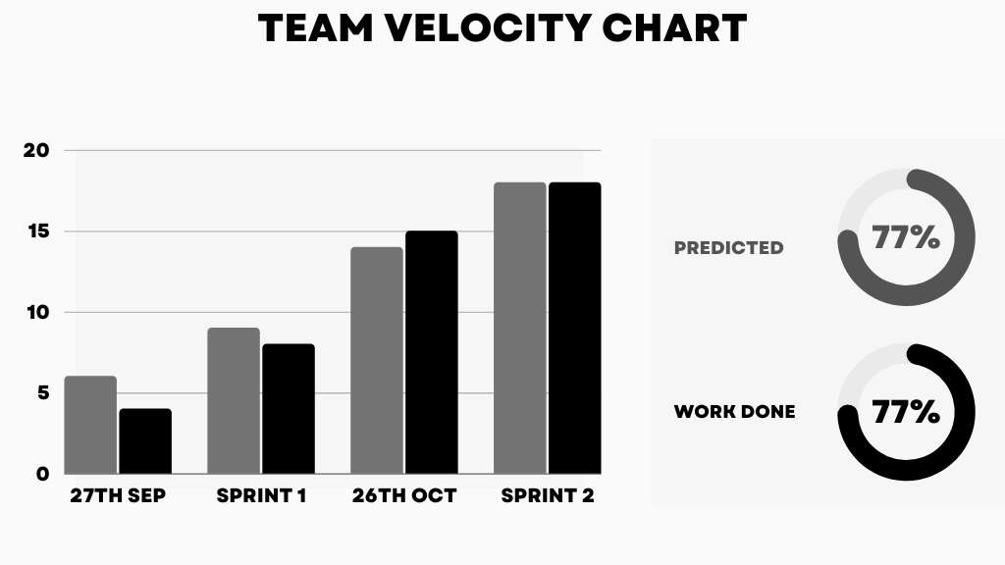
26th OCT
SPRINT 2
30th NOV
SPRINT 3

Slide 42
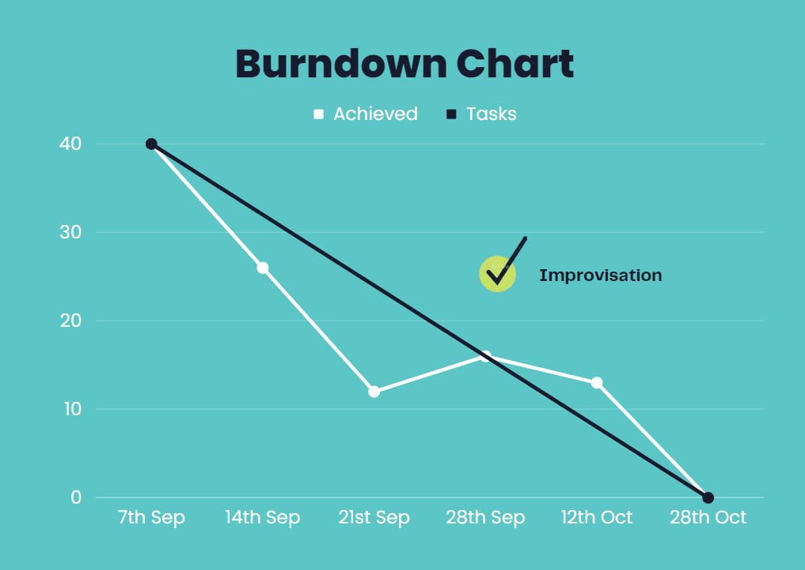
14TH SEP
21ST SEP
28TH SEP
12TH OCT
28TH OCT
30TH NOV
14TH SEP

Slide 43
RETROSPECTIVE

Slide 44
What went well?
Meetings went according to the scheduled manner and the team members complemented each other well.
We were able to produced the new and challenging project proposal.
Tried hands-on on the technologies that we have decided.

Slide 45
What didn’t go well?
Took more time to work on the login page.
We need to add more user stories ideas.
Took time because we worked on new technologies
Tried hands-on on the technologies that we have decided.

Slide 46
What we did to improve?
Need to improve time-management and spend more time to work on task to avoid last minute hassle.
Tried to stay committed to deadlines and improve communication between teammates.
Complete working on the MVP and start focusing on sprint 3.

Slide 47
SPRINT - 4

Slide 48
Stories Planned for Sprint 4
ID | User story | Acceptance Criteria
SAT-4 | As a new user I want to enter my inputs age,height,weight activity So that I get recommendations based on my system | Scenario when user wants to give inputs Given he gives inputs and enters submit Then his information gets stored And the system displays his information
SAT-5 | As a new user I want to navigate to all the services in the application So that I can get all the services of the application | Scenario when user wants to navigate Given he wants to know the services listed Then user gets to know all the services in the application
SAT-9 | As a new user I want to reset my password So that I can Login again | Scenario when user forgets his password Given he changes his password Then the system stores his new password
SAT-8 | As a new user I want to edit my personal Information So that I can get recommendations based on changed information | Scenario when user wants to edit his information Given he changes his information And he changes his information And he submits the information And his information is updates

Slide 49
APPLICATION SCREENSHOTS

Slide 50
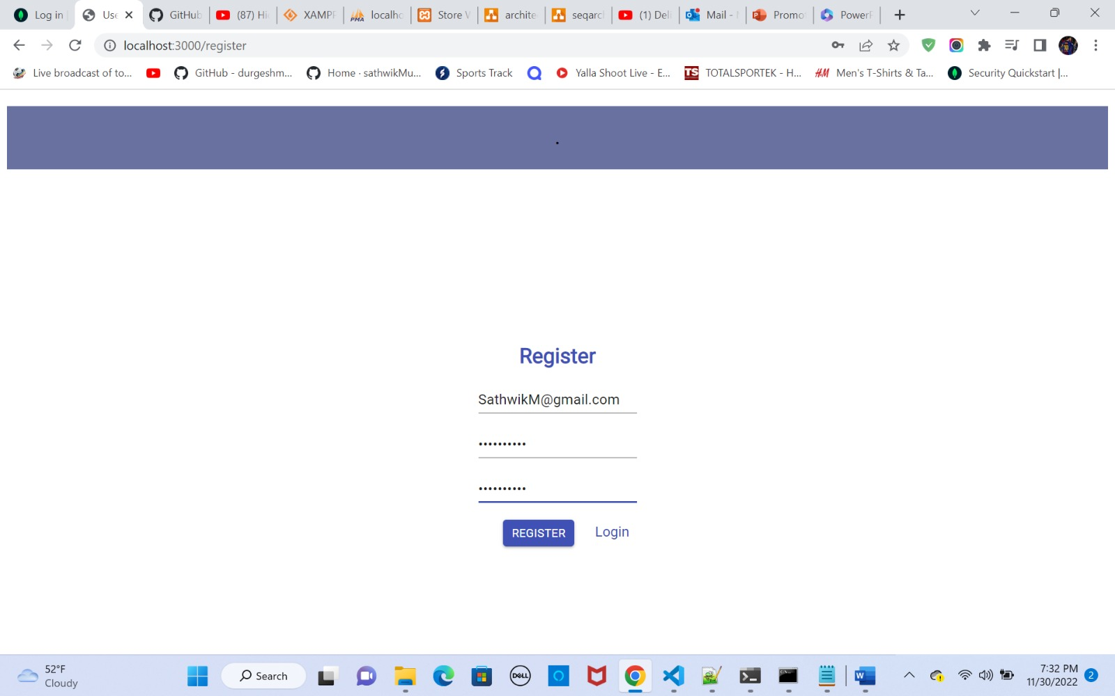

Slide 51
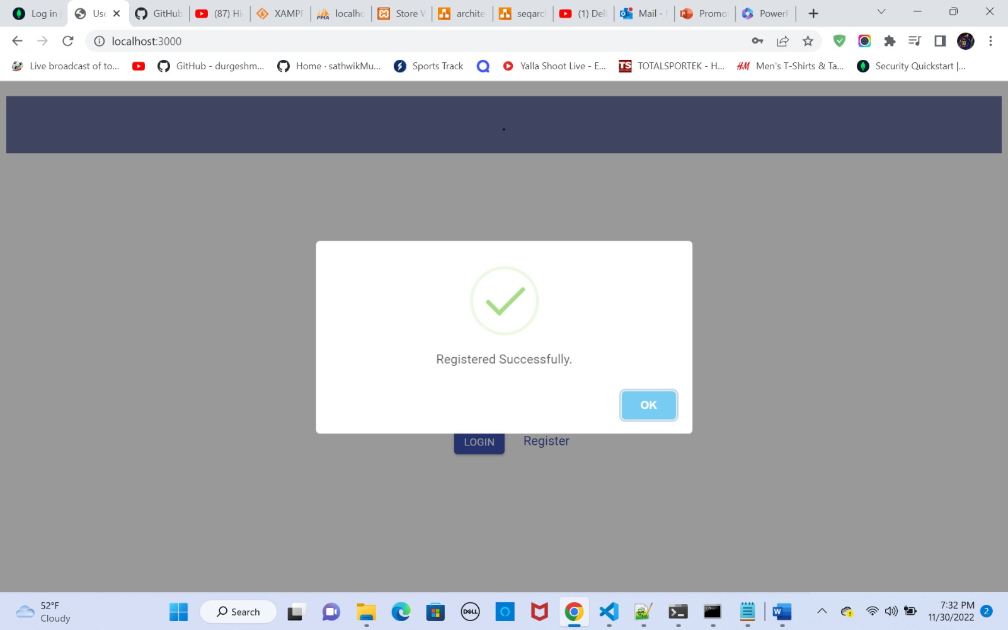

Slide 52
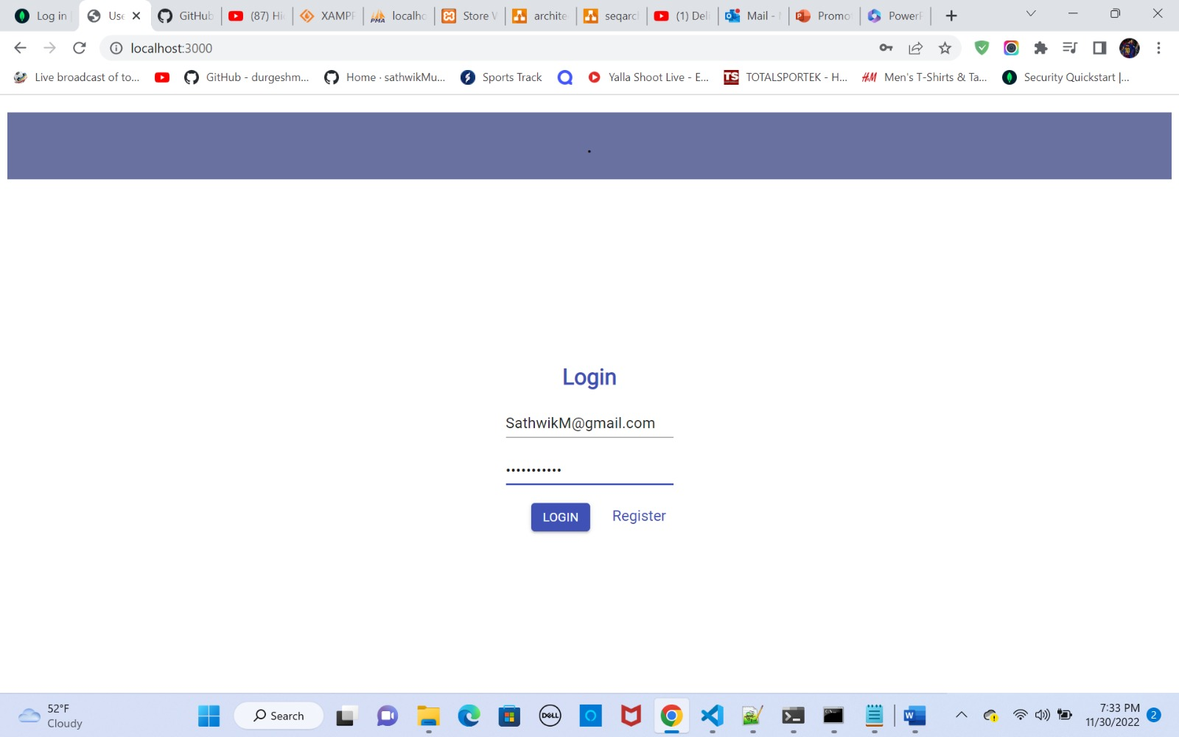

Slide 53
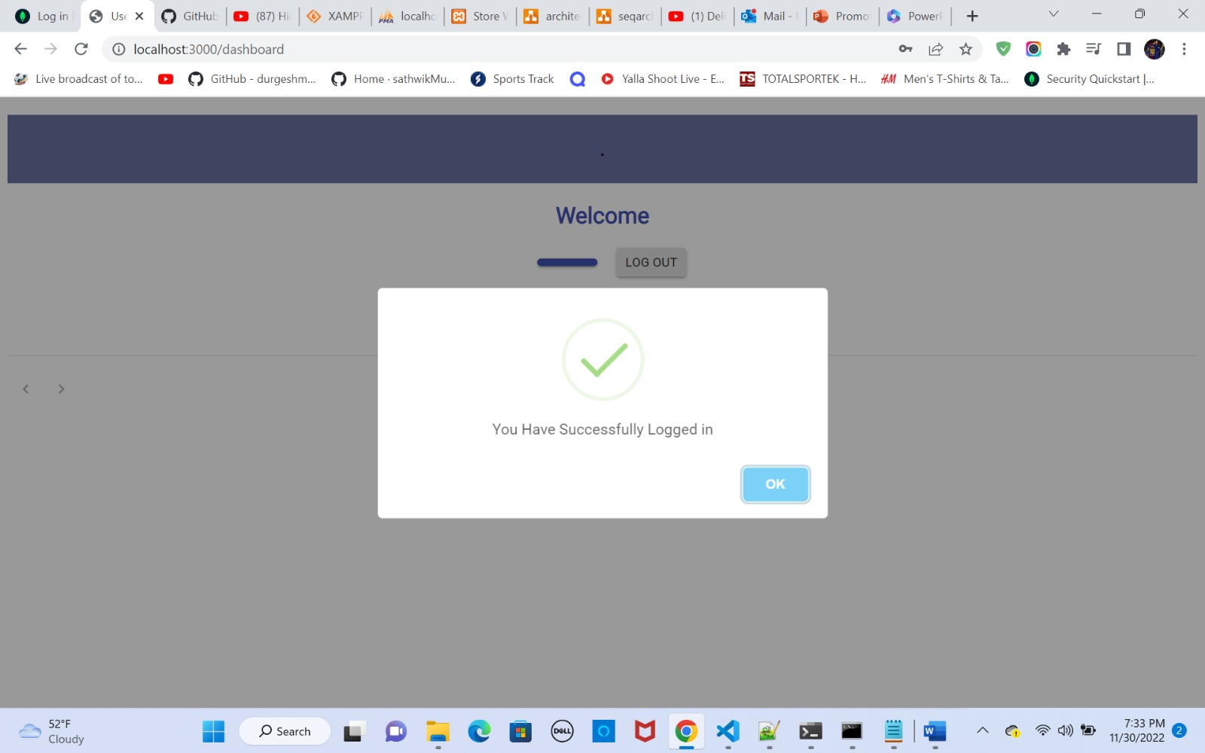

Slide 54

Git-hub Link
https://github.com/sathwikMudenti/Project_images/wiki

Slide 55

Happy eating
THANK YOU

